Slide 1
ELEC 3300 Final Presentation
Ieong, Zi Liang jason (zljieong)
Yim Man Chak (mcyim)

Slide 2
Project Idea
Reinventing remote robot with 3D input
Joystick? No! Just turn your wrist~

Slide 3
Ideas Behind…
Omni Wheels Robot capable of rotating around Z-axis and forward/backward towards any direction
3D motion input?
References:
Right: How to build an Omni Wheels Robot
Left: Motion-sensing game controllers explained

Slide 4
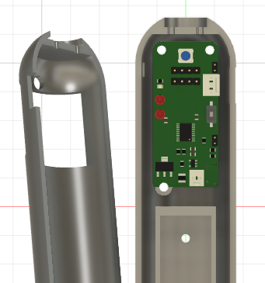
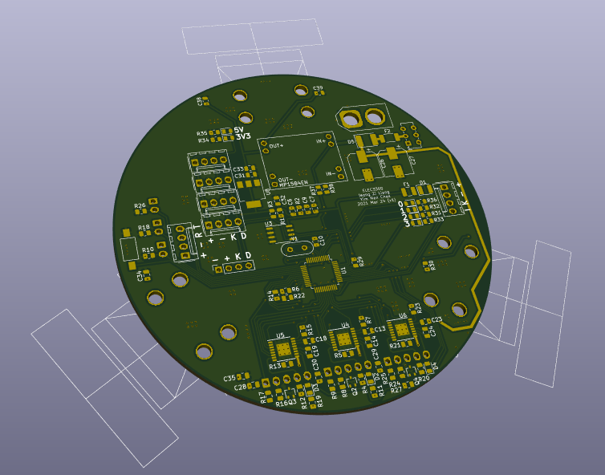
Project Deliverables
🎮
Handheld remote
🤖
Omni-wheels Robot
Bluetooth

Slide 5
Project Design
Remote 🎮
Robot 🤖

Slide 6
Features
🎮
🤖
Inertia Measurement Unit
MPU6050 with complement filter
Battery
Then it’s truly handheld
Bluetooth
Communication with Car
I2C LCD & Buttons
User interaction & provide remote and car info
3 Omni-wheels
Has own encoder and PID control loop
6 RGB LEDs
Better user experience
Bluetooth
Communication with Remote
Battery
No more cable!

Slide 7
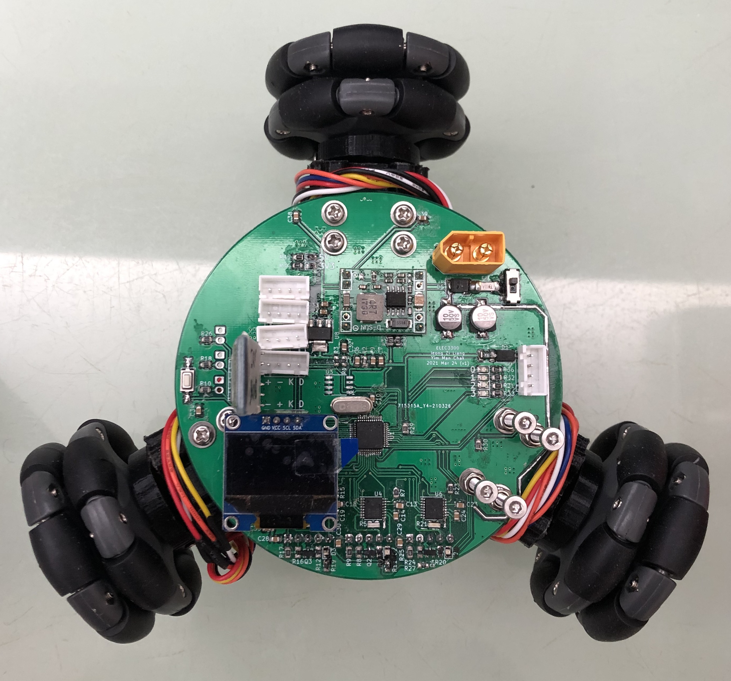
Car Top View
Additional I2C Ports
BT
Batt Socket
Reset Button
Debug Port
STM32
F103
LCD
Motor Drivers

Slide 8
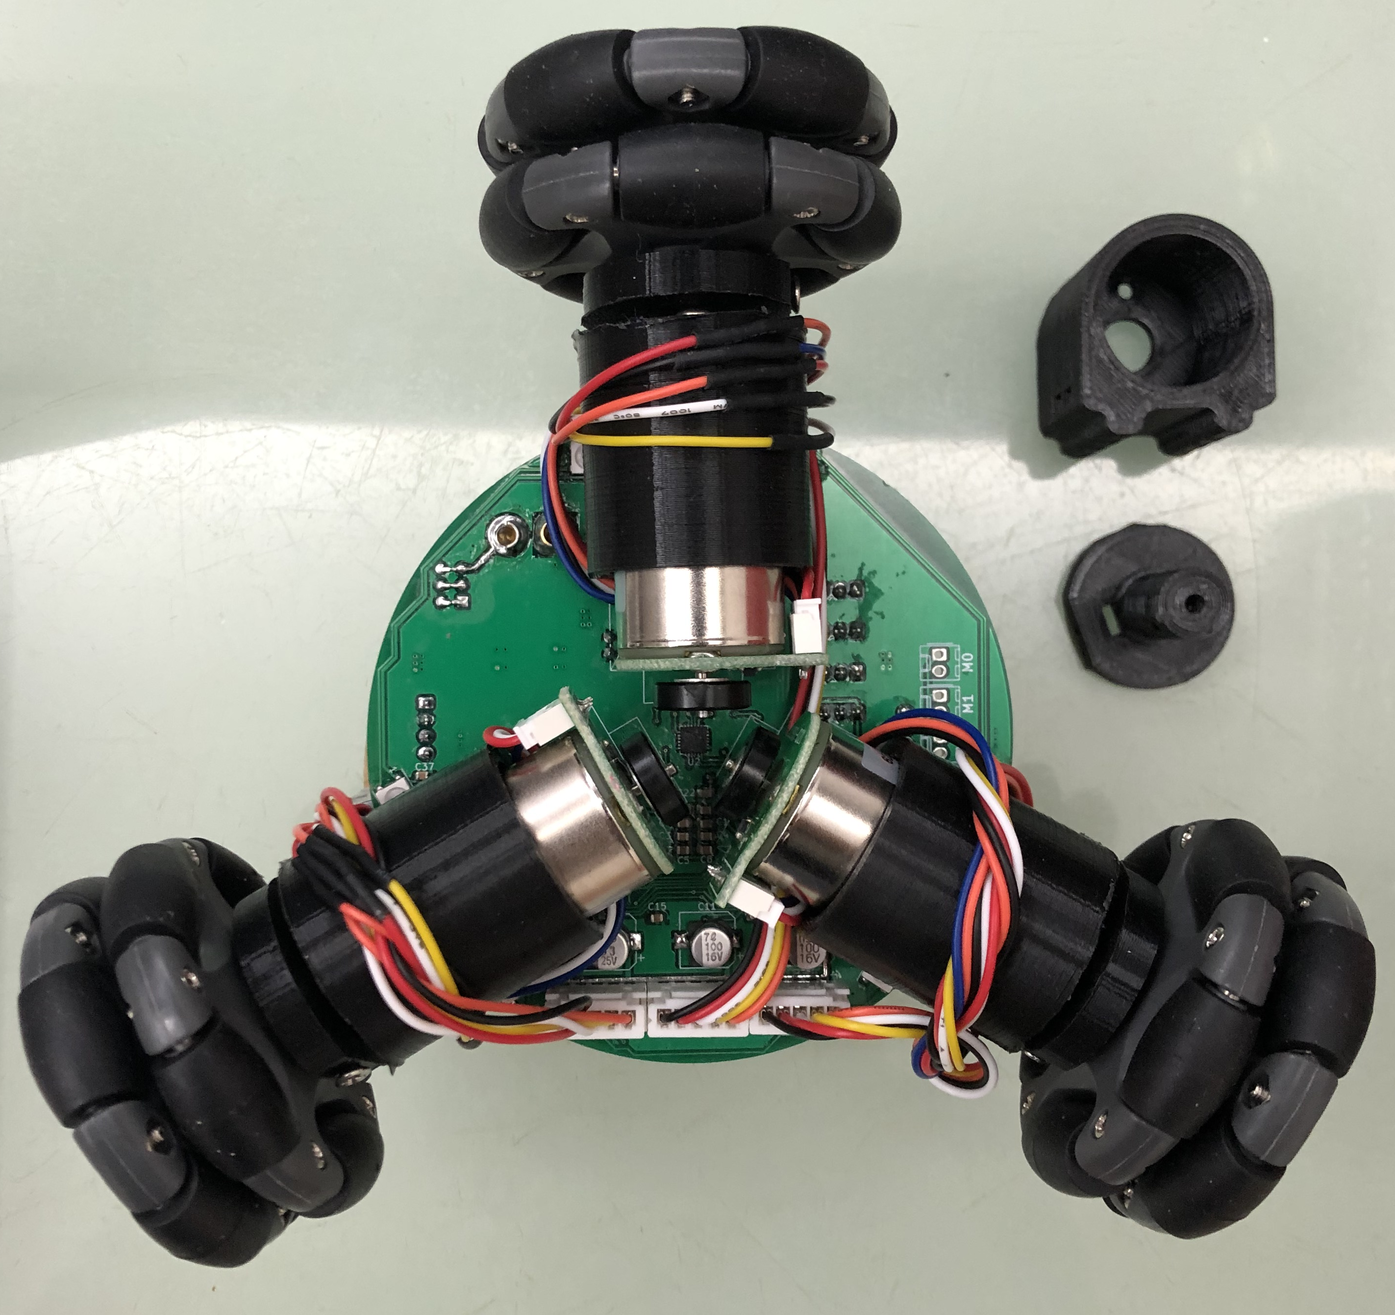
Car Bottom View
Motor Mount
RGB LEDs
Motor Shaft
Motor & Encoder

Slide 9
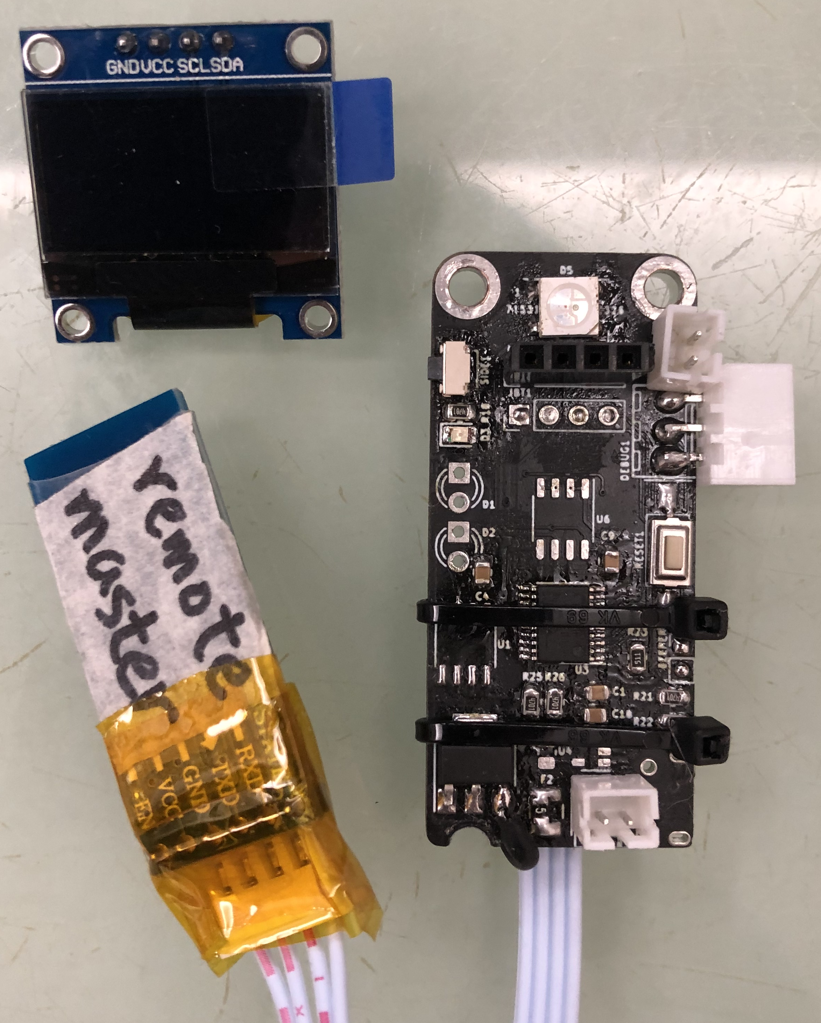
Remote Top View
Side Button Port
LCD Port
Top Button Port
Debug Port
Reset Button
Stm8s003
Battery Port

Slide 10
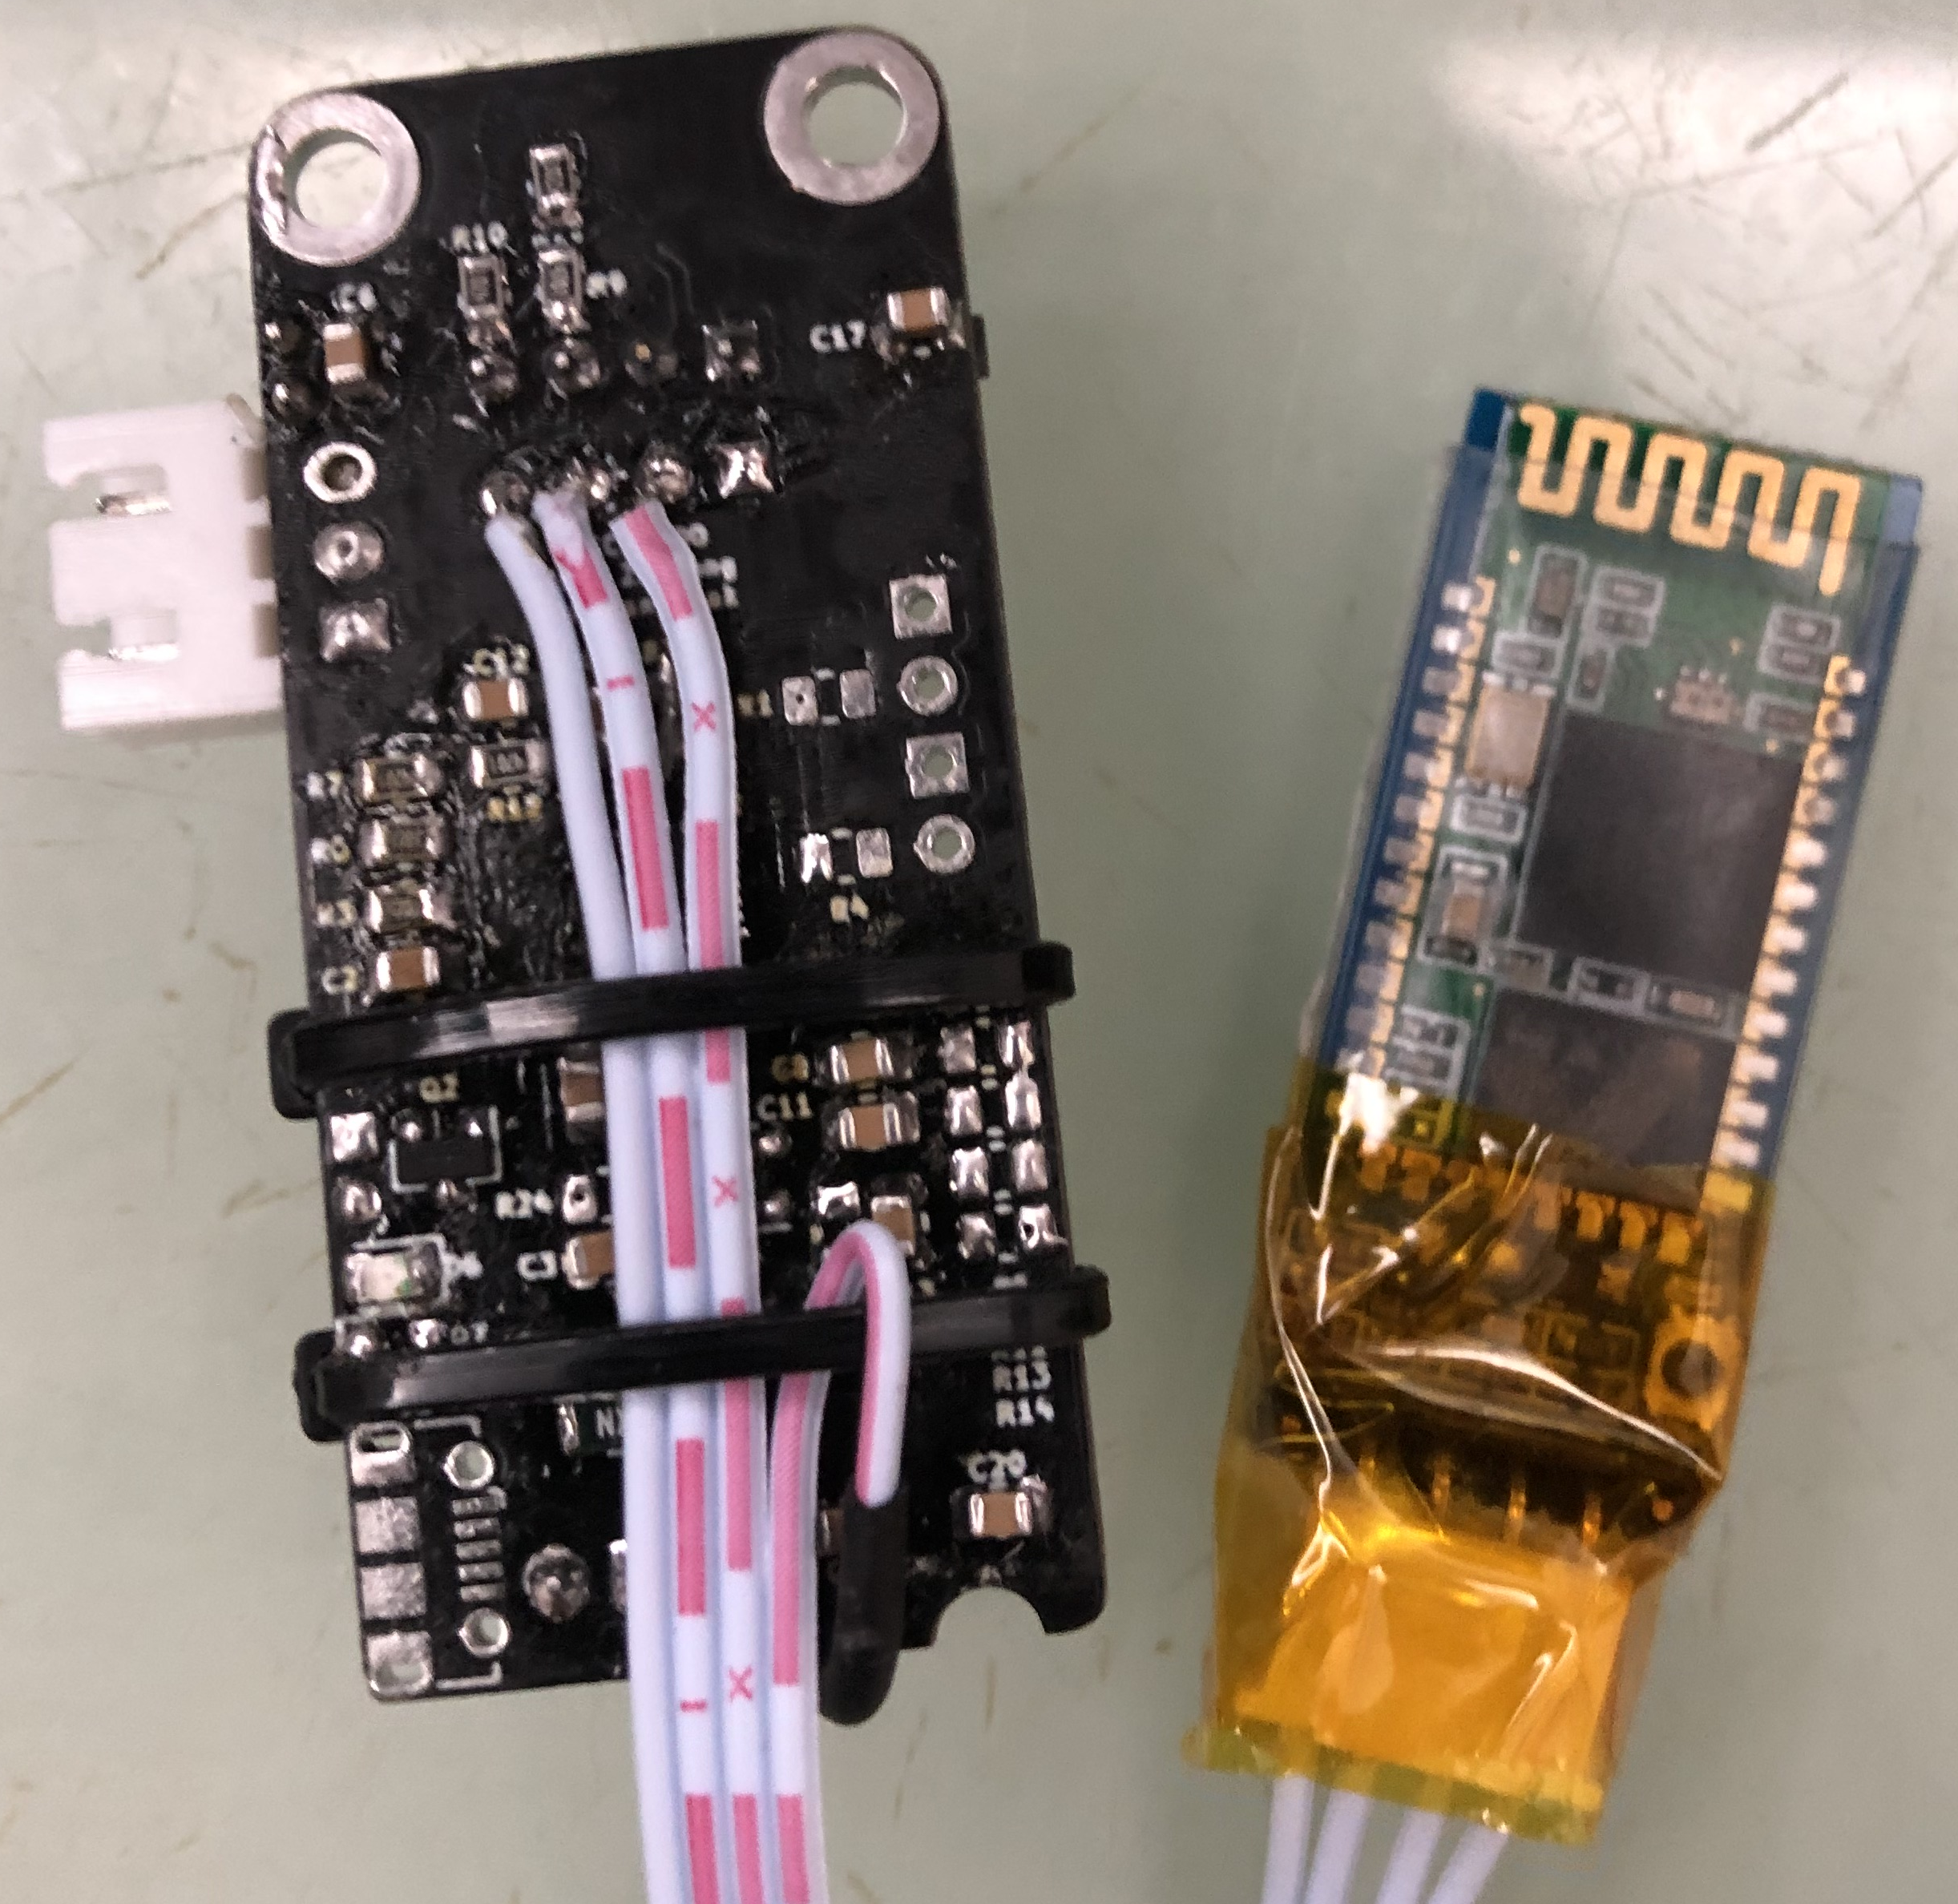
Remote Bottom View

Slide 11
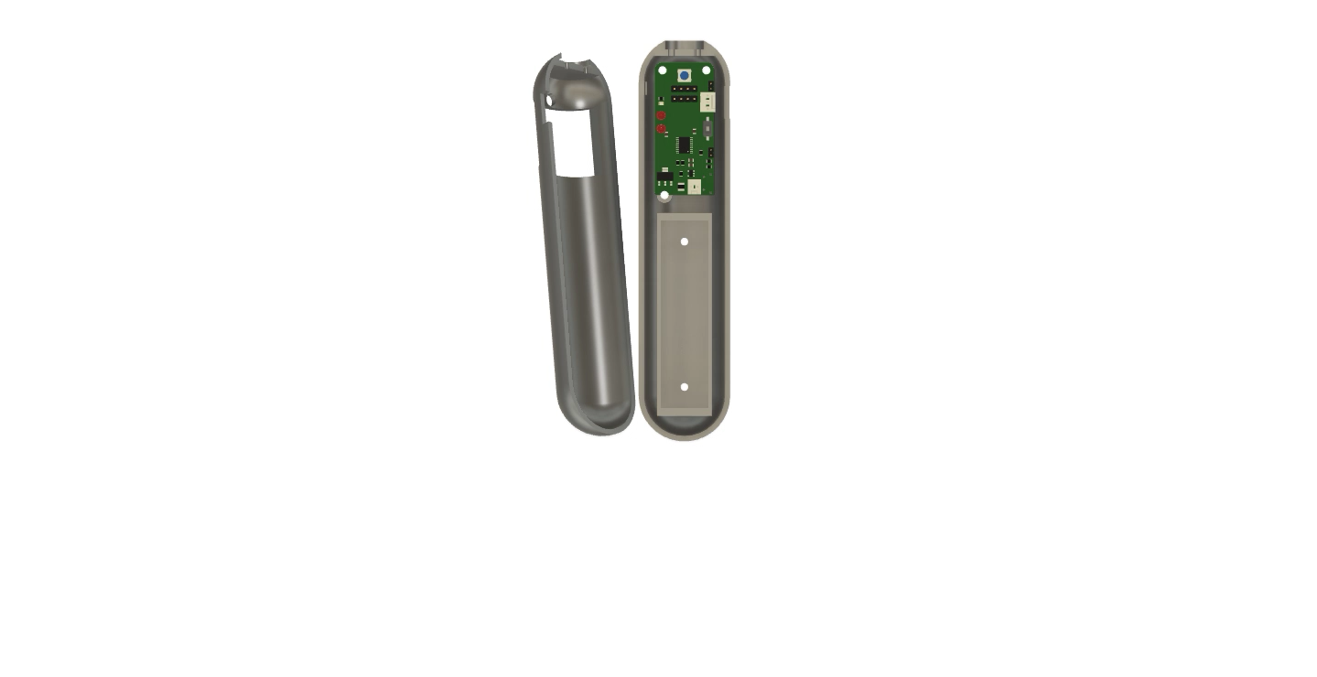
Remote Case View

Slide 12
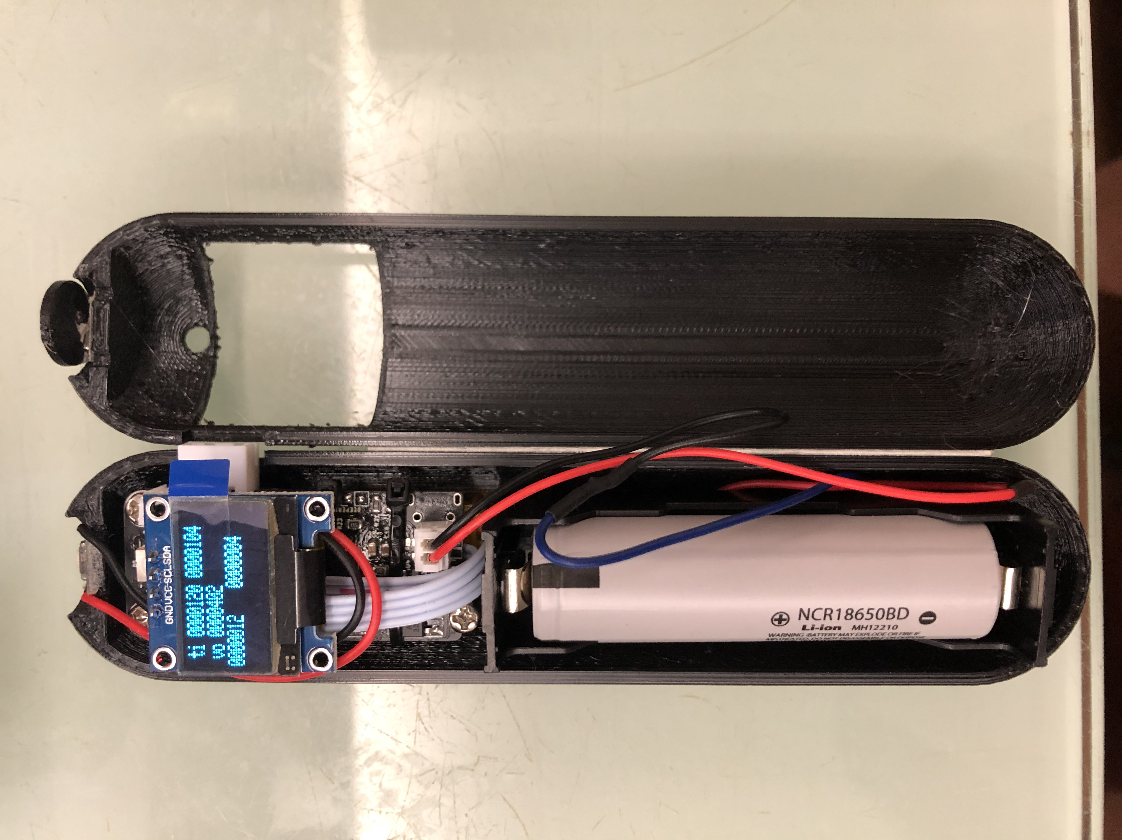
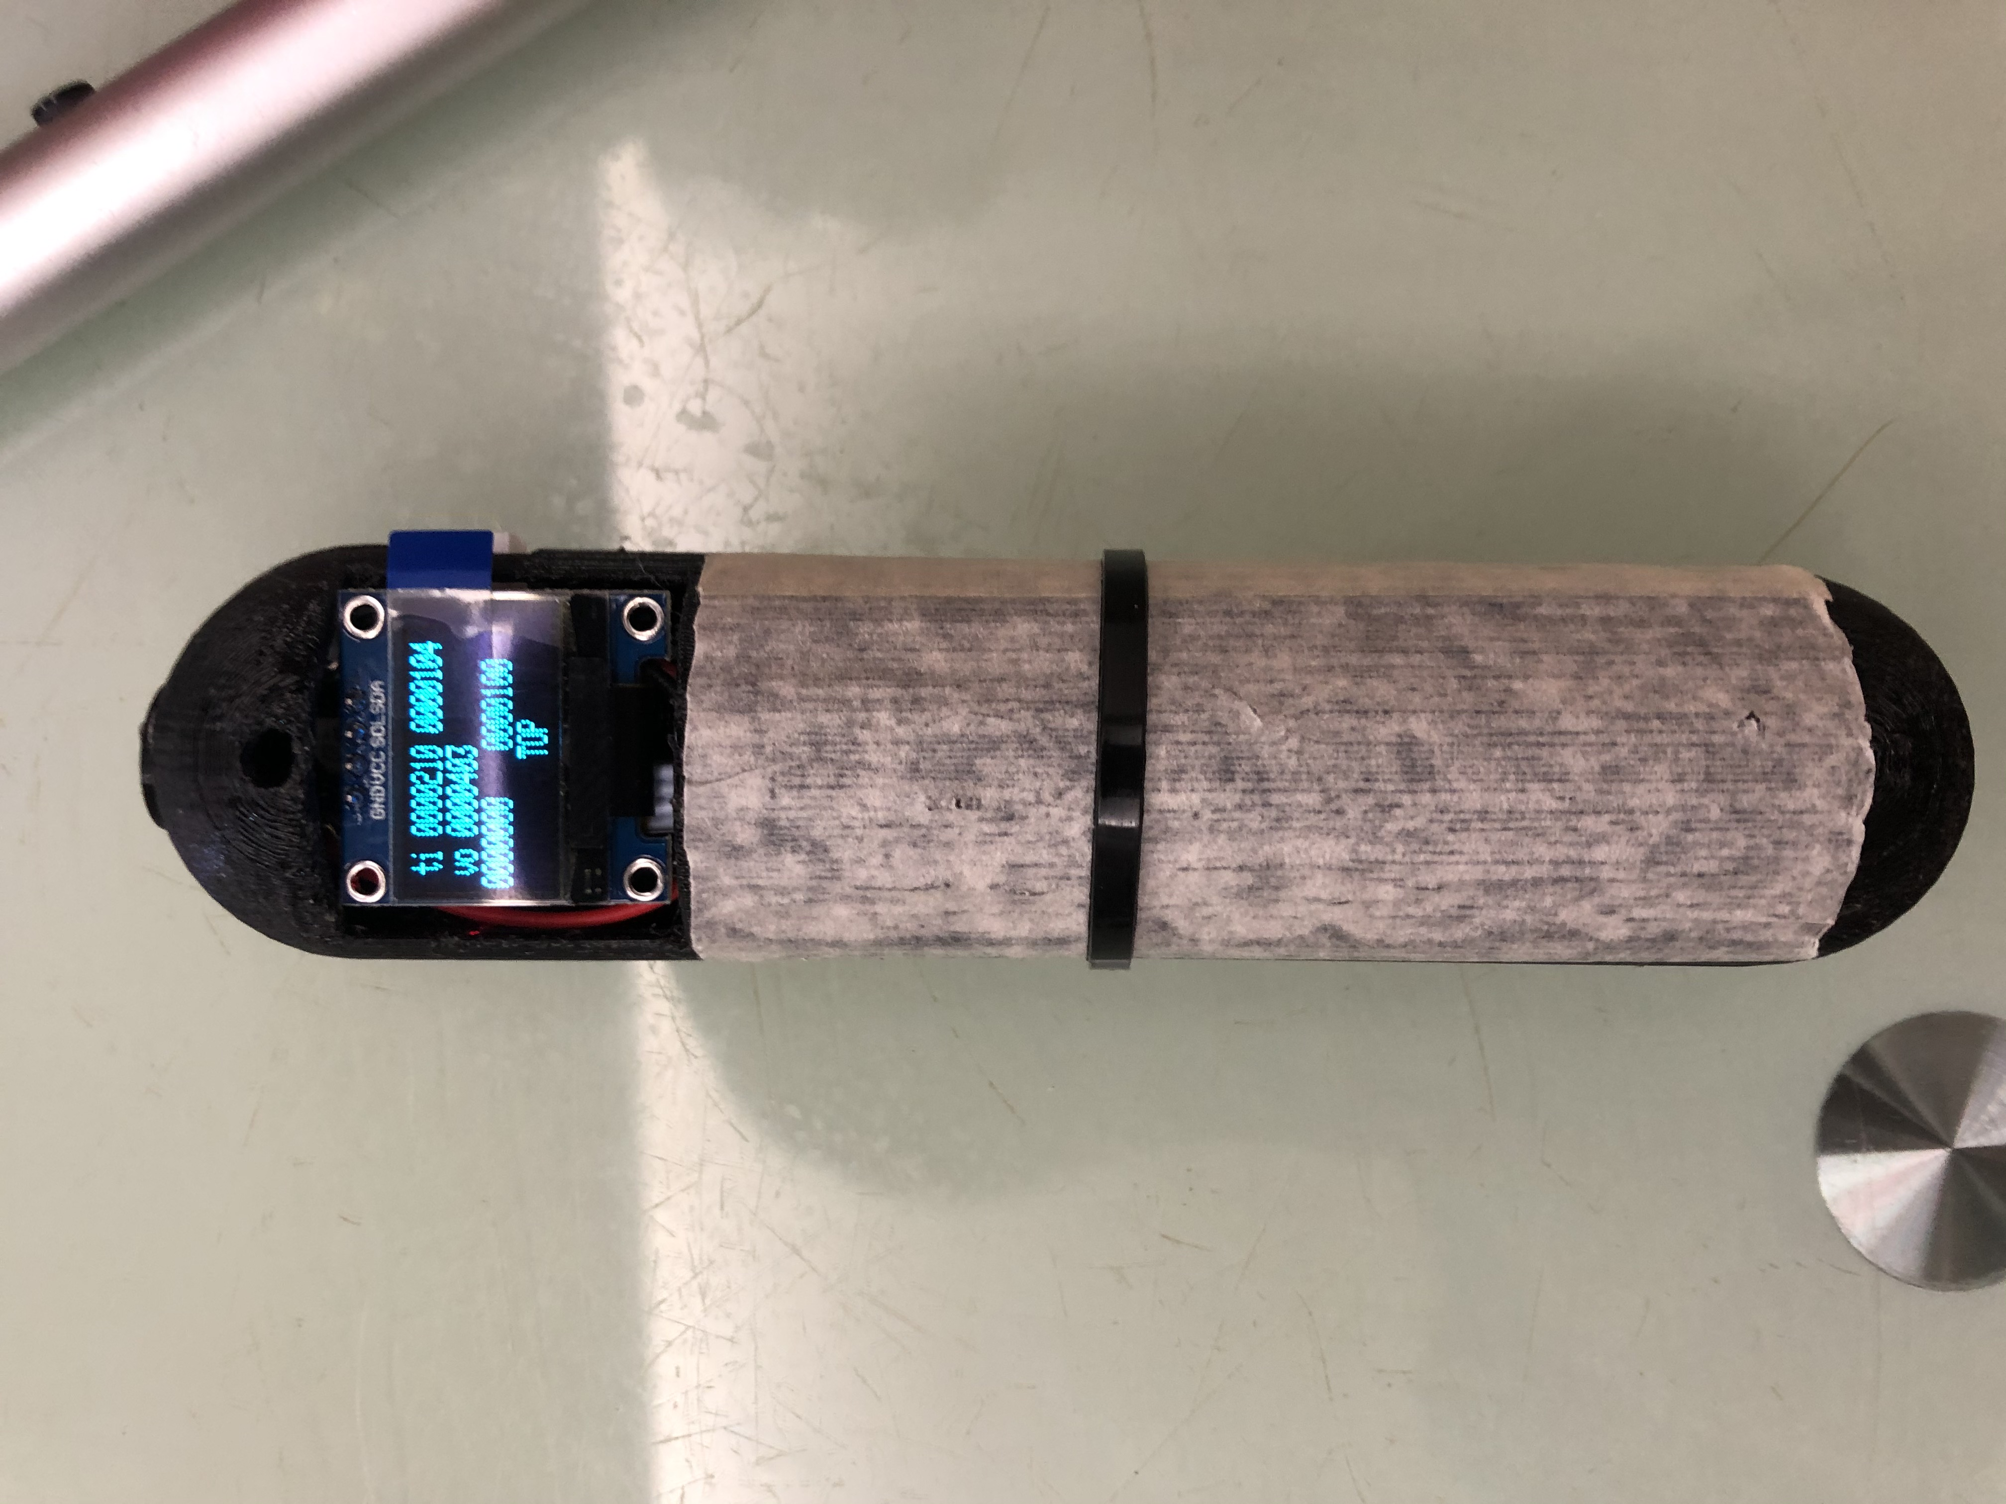
Remote Case View
Top Button
PCB
(BT below)
18650 Battery

Slide 13
Feature Highlights
Motion Sensing
Closed loop motion control

Slide 14
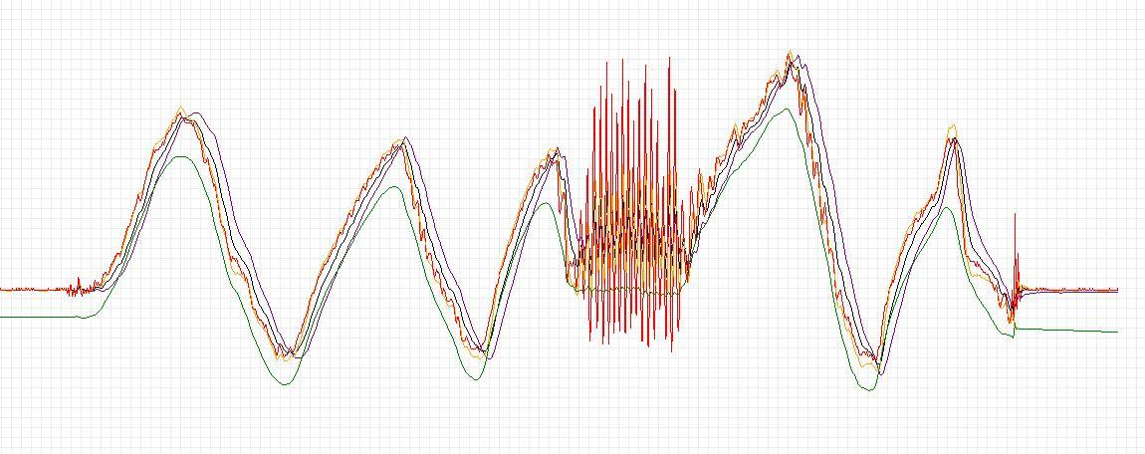
Motion Sensing
🎮
Motion Sensing with MPU6050
Known issues:
Gyroscope drifts
Accelerometer unstable
Solution
Complementary Filter
Image source: https://robottini.altervista.org/kalman-filter-vs-complementary-filter

Slide 15
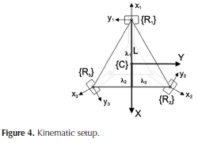
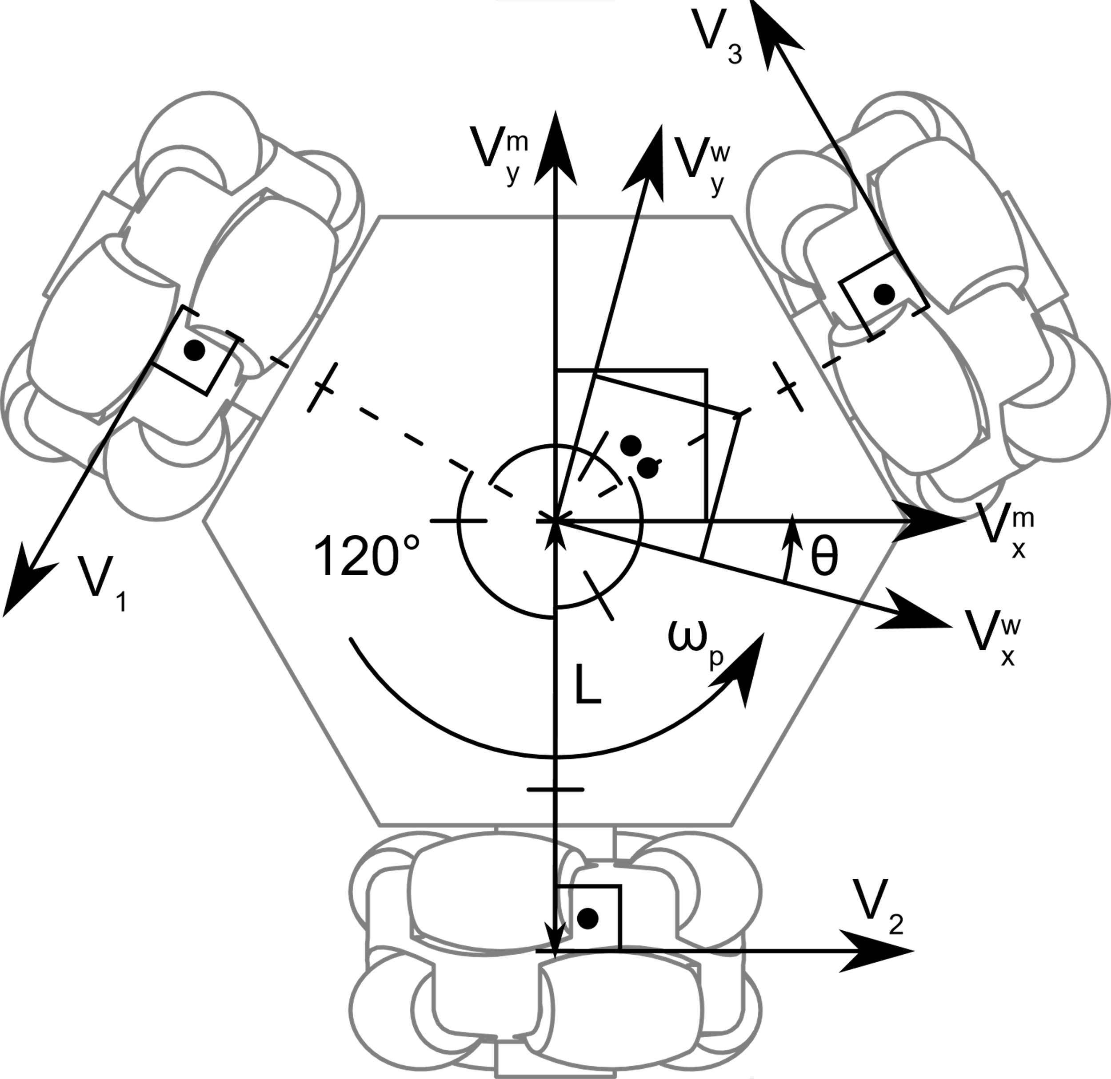
Closed Loop PID Control
🤖
Motor Control
Known issue
Each Omni wheel introduce error
Solution
Encoder + PID control
Image source: https://www.roboteq.com/images/article-images/frontpage/wheel-rotations.jpg

Slide 16
Demo Video

Slide 17
Easter Egg 🐰

Slide 18
Thank you!

